Slide 1

Systems Development Life Cycle (SDLC)

Slide 2
Process in System Development
Membawa permintaan kebutuhan (perubahan) software (System Request) ke System Analyst
System Analyst membuat analisis kelayakan (Feasibility Analysis) dari System Request tersebut
Setelah dinyatakan layak, proses analysis dan design dilakukan oleh System Analyst, dan hasilnya adalah System Specification
  Business Analyst membantu System Analyst memahami proses bisnis dan knowledge berhubungan dengan software yang akan dibangun
System Specification diserahkan oleh System Anayst ke Programmer untuk dilakukan Construction (Coding)
Hasil Construction berupa Kode Program diserahkan ke Software Tester untuk diuji (Unit, Integration, System, User Acceptance Testing)
Kode Program + Dokumentasi (Pengembangan dan Penggunaa) + Laporan Testing = Software
Siklus kembali ke 1 apabila ada permintaan perubahan (Permintaan Perubahan Software)
Planning
(System Proposal)
Analysis and Design
(System Specification)
Implementation
(Software)
Evolution
(Updated Software)

Slide 3
Systems Development Life Cycle (SDLC)
Implementation
Design
Analysis
Planning
(Shelly, 2012) (Dennis, 2016) (Valacich, 2017)

Slide 4
Systems Development Life Cycle (SDLC)
Planning: Why build the system?
  System request, feasibility analysis, project size estimation
Analysis: Who, what, when, where will the system be?
  Requirement gathering, business process modeling
Design: How will the system work?
  Program design, user interface design, data design
Implementation: System construction and delivery
  System construction, testing, documentation and installation

Slide 5
Planning
Identifying business value (System Request)
  Lower costs
  Increase profits
Analyze feasibility
  Technical Feasibility
  Economic Feasibility
  Organizational Feasibility
(System Proposal)

Slide 6
Planning (System Proposal)
System Request
(Business Value Identification)
Lower Cost
Increase Profit
Feasibility Analysis
Technical (Capabilities)
Economic
(ROI, BEP)
Organizational
(Goals, Core Business)

Slide 7
System Request: Sistem Penjualan Musik Online
Project Sponsor: | Margaret Mooney, Vice President of Marketing
Business Needs: | Project ini dibangun untuk: Mendapatkan pelanggan baru lewat Internet Meningkatkan efisiensi penanganan masalah pelanggan melalui internet
Business Requirements:
Sistem yang mendukung penjualan musik secara online. Fitur-fitur yang harus ada: Fitur Pencarian Produk Fitur Pencarian Toko yang Menyediakan Stok Produk Fitur Pemesanan Produk Melalui Toko yang Menyediakan Fitur Pembayaran dengan Berbagai Pilihan Pembayaran
Business Value:
Intangible Value: Meningkatkan kenyamanan dan kepuasan pelanggan Meningkatkan brand recognition tentang perusahaan di dunia Internet Tangible Value: 1. Meningkatkan penjualan dari pelanggan baru lewat Internet: Rp 400 juta peningkatan penjualan dari pelanggan baru dan Rp 600 juta dari pelanggan lama 2. Mengurangi biaya operasional untuk menangani komplain dari pelanggan Rp 100 juta pengurangan tahunan biaya telepon untuk menangani pelanggan

Slide 8
Studi Kelayakan Sistem Penjualan Musik Online
Margaret Mooney dan Alec Adams membuat studi kelayakan untuk pengembangan Sistem Penjualan Musik Online
Kelayakan Teknis Sistem penjualan musik online layak secara teknis, meskipun memiliki beberapa risiko. Risiko Berhubungan dengan Kefamilieran dengan Aplikasi: Resiko Tinggi Divisi Marketing tidak memiliki pengalaman menggunakan sistem penjualan online Divisi IT memiliki pemahaman yang baik tentang sistem penjualan offline, akan tetapi tidak berpengalaman mengembangkan sistem penjualan musik online Risiko Berhubungan dengan Kefamilieran dengan Teknologi: Resiko Sedang Divisi IT tidak menguasai masalah infrastruktur dan ISP, tetapi akan menyewa konsultan Divisi IT cukup familier dengan framework dan IDE yang akan digunakan Divisi Marketing tidak memiliki pengalaman menggunakan teknologi Web Risiko berhubungan dengan Ukuran Project: Risiko Rendah Perusahaan memiliki total 30 orang pengembang Project dikerjakan oleh 5 orang pengembang dengan estimasi waktu 6 bulan Kompatibilitas dengan sistem dan infrastruktur yang ada: Risiko Rendah Sistem pemesanan yang ada sekarang menggunakan open standard, jadi sangat kompatibel dengan sistem penjualan berbasis web yang akan dibangun

Slide 9
Kelayakan Ekonomi
Cost benefit analysis telah dilakukan. Sistem Penjualan musik online memiliki peluang yang baik untuk bisa meningkatkan pendapatan perusahaan. Return on Investment (ROI) setelah 3 tahun: 31% Break-even point (BEP): 2.25 tahun Total keuntungan setelah 3 tahun: Rp. 503.559.986,- Keuntungan Intangible Meningkatkan kepuasaan pelanggan Meningkatkan branding perusahaan
Kelayakan Organisasi
Secara organisasi, resikonya rendah. Tujuan dari pengembangan sistem penjualan musik online adalah meningkatkan penjualan perusahaan. Dan ini selaras dengan KPI marketing yang ke arah peningkatan kuantitas penjualan Project champion dari pengembangan sistem penjualan musik online ini adalah Margaret Mooney, Vice President of Marketing

Slide 10
 | 2019 | 2020 | 2021
Peningkatan penjualan dari pelanggan baru | 0 | 400,000,000 | 500,000,000
Peningkatan penjualan dari pelanggan lama | 0 | 600,000,000 | 700,000,000
Pengurangan biaya operasional dan telepon | 0 | 100,000,000 | 100,000,000
Total Benefits: | 0 | 1,100,000,000 | 1,300,000,000
PV of Benefits: | 0 | 978,996,084 | 1,091,505,068
PV of All Benefits: | 0 | 978,996,084 | 2,070,501,152
Honor Tim (Analysis, Design and Implementation) | 360,000,000 | 0 | 0
Honor Konsultan | 90,000,000 | 0 | 0
Total Development Costs: | 450,000,000 | 0 | 0
Honor Pengelola Web | 60,000,000 | 70,000,000 | 80,000,000
Biaya Lisensi Software | 50,000,000 | 60,000,000 | 70,000,000
Hardware upgrades | 100,000,000 | 100,000,000 | 100,000,000
Biaya Komunikasi | 20,000,000 | 30,000,000 | 40,000,000
Biaya Marketing | 100,000,000 | 200,000,000 | 300,000,000
Total Operational Costs: | 330,000,000 | 460,000,000 | 590,000,000
Total Costs: | 780,000,000 | 460,000,000 | 590,000,000
PV of Costs: | 735,849,057 | 409,398,362 | 495,375,377
PV of all Costs: | 735,849,057 | 1,145,247,419 | 1,640,622,796
Total Project Costs Less Benefits: | -780,000,000 | 640,000,000 | 710,000,000
Yearly NPV: | -735,849,057 | 569,597,722 | 669,811,321
Cumulative NPV: | -735,849,057 | -166,251,335 | 503,559,986
Return on Investment (ROI) di Tahun 3: 30.70% | -100.00% | -0.145166304 | 0.306932213
Break-even Point (BEP): 2.25 tahun |  |  | 2.248206218

Slide 11
Analysis
Requirement gathering by answering the questions:
  Who will use the system?
  What will the system do?
  When will it be used?
Investigate the current system
Identify possible improvements
Develop a concept for new system
(System Specification)

Slide 12
Design
Program Design
  What programs need to be written
  Exactly what each program will do
User Interface Design
  How users interact with system
  Forms / reports used by the system
Data Design
  What data is to be stored
  What format the data will be in
  Where the data will be stored
  (System Specification)

Slide 13
Implementation
Construction
  New system is built and tested
  Often testing is the longest part
Testing
  Unit Testing
  Integration Testing
  System Testing
  User Acceptance Test
Documentation
  User Documentation
  System Documentation
Installation
  Old system is turned off
  New system is turned on

Slide 14
Processes and Deliverables
Process
Product
Planning
Analysis
Design
Implementation
System Proposal
System Specification
New System with Testing/Maintenance Plan

Slide 15

Systems Development Methodology (Model Process)

Slide 16
Software Development Methodology
(Model Process)
A formalized approach to implementing the Software Development Life Cycle (SDLC) (Dennis, 2012)
A simplified representation of a software process (Sommerville, 2015)
A distinct set of activities, actions, tasks, milestones, and work products required to engineer high quality software (Pressman, 2015)

Slide 17
Major Software Development Methodologies
Structured Design
(Prescriptive) (1967- )
  Waterfall method
  Parallel development
Rapid Application Development (Iterative) (1985-)
  Phased Development
  Prototyping
Agile Development
(Adaptive) (1995-)
  Extreme Programming (XP)
  Scrum
More Prescriptive/
Documentation
More
Adaptive/
Communication
Compiled from (Dennis, Wixom and Tegarden, 2016)

Slide 18
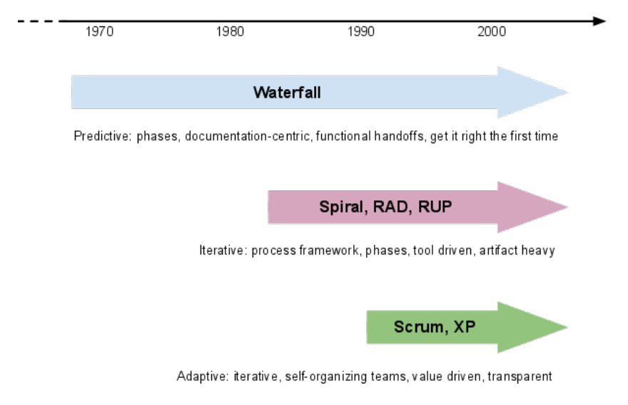
Methodology Timeline

Slide 19

Structured Design

Slide 20
Structured Design
Projects move methodically from one to the next step
Generally, a step is finished before the next one begins
Type of Structured Design:
Waterfall Method
Parallel Development

Slide 21
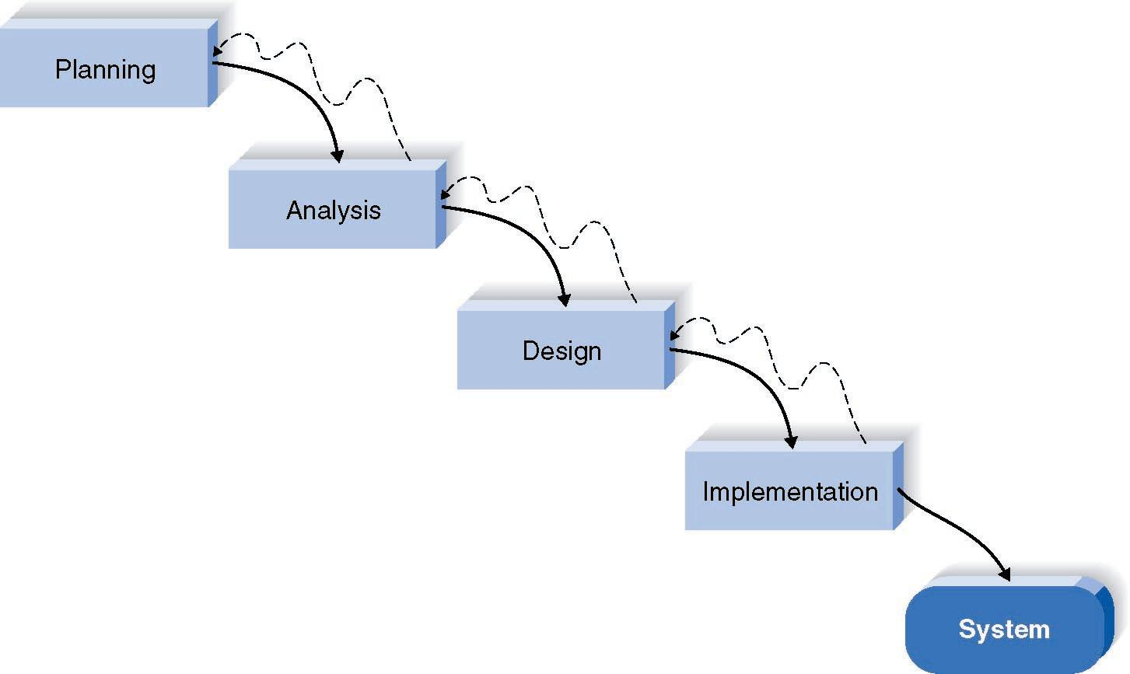
Waterfall Method
Pros | Cons
Identifies systems requirements long before programming Begins, it minimizes change to the requirements as the project proceed (mature) | Design must be specified on paper before programming begins
 | Long time between system proposal and delivery of new system
 | Rework is very hard

Slide 22
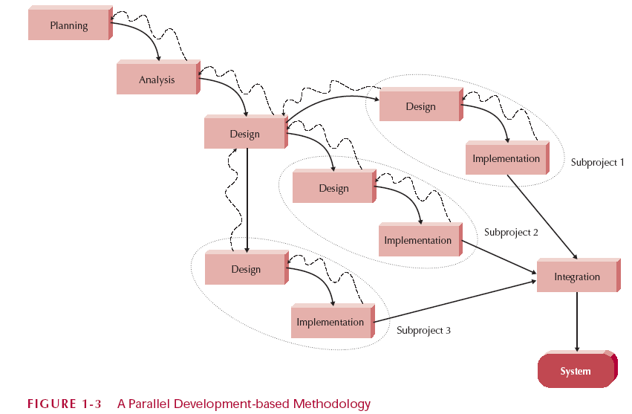
Parallel Development
Addresses problem of time gap between proposal and delivery:
Breaks project into parallel subproject
Integrates them at the end

Slide 23
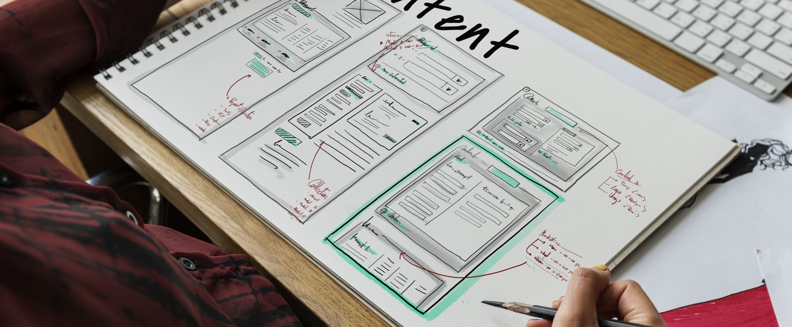
Rapid Application Development

Slide 24
Rapid Application Development (RAD)
Type of RAD:
Phased development: a series of versions
Prototyping: System prototyping
Throw-away prototyping: design prototyping
Critical elements to speed up the SDLC:
CASE tools
Visual programming languages
Code generators

Slide 25
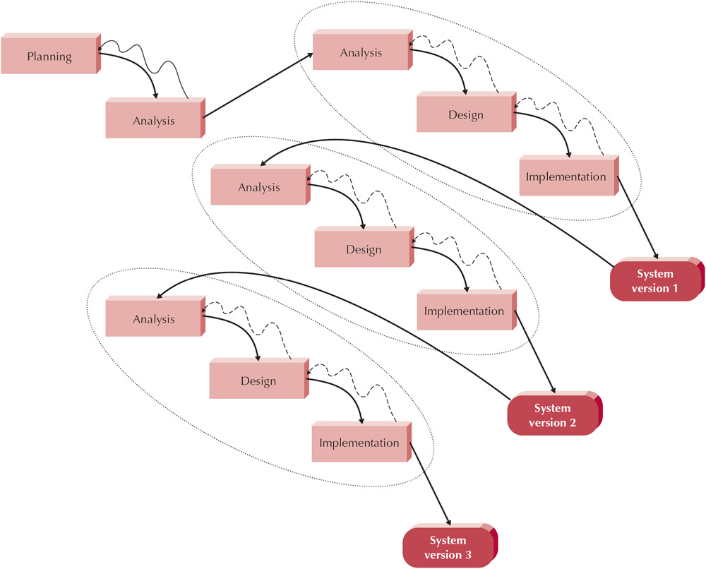
RAD: Phased Development
Pros | Cons
Gets useful system to users quickly | Initial system is intentionally incomplete
Most important functions tested most | System requirements expand as users see versions

Slide 26
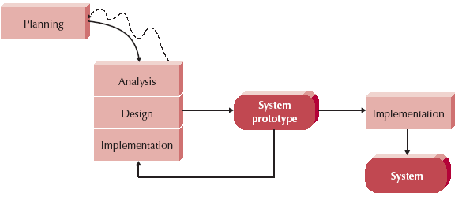
RAD: Prototyping
Analysis, Design, Implementation are performed concurrently
Start with a "quick-and-dirty" prototype, Provides minimal functionality
Repeat process, refining the prototype each time
Stop when prototype is a working system
Prototyping significantly reduces requirement and design errors, especially for user interfaces (Boehm’s First Law, Endres, 2013)

Slide 27
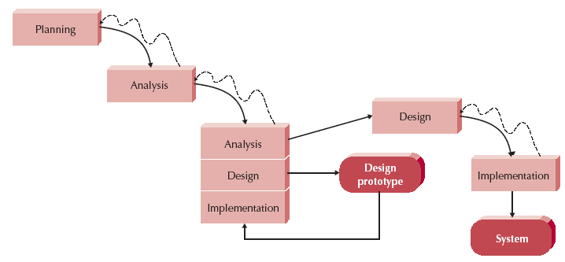
RAD: Throw-Away Prototyping
Use prototypes only to understand requirements
  Example: use html to show UI
Prototype is not a working design
Once requirements are understood, the prototypes are thrown away

Slide 28

Agile Development

Slide 29
Agile Development
Just a few rules that are easy to learn and follow
Streamline the SDLC
Eliminate much of the modeling and documentation
Emphasize simple, iterative application development
Type of Agile Development:
Extreme Programming (XP) (Kent Beck)
Scrum (Ken Schwaber and Jeff Sutherland)
Lean Development (Mary Poppendieck and Tom Poppendieck)
Dynamic Systems Development Model (DSDM) (Dane Faulkner)

Slide 30
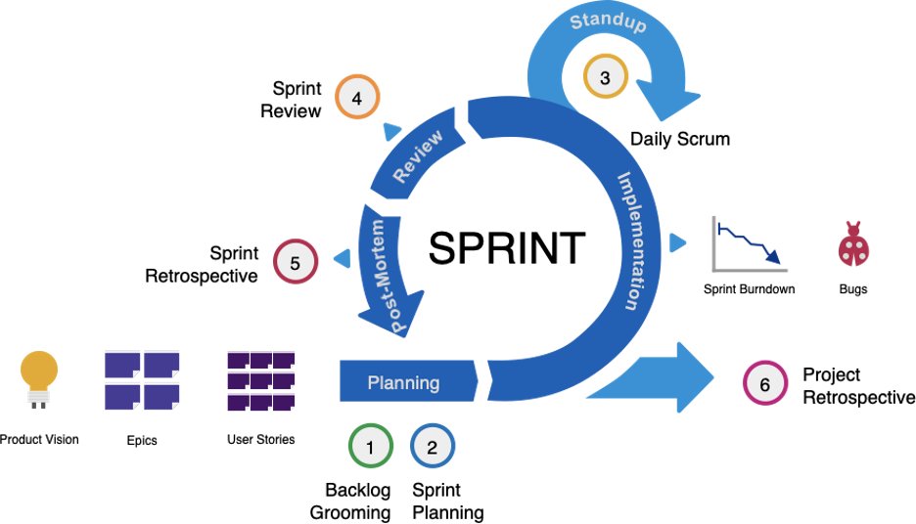
Agile Process

Slide 31
Methodology Selection Strategy

Slide 32
Selection Factors
Clarity of User Requirements
Familiarity with Technology
System Complexity
System Reliability
Short Time Schedules
Schedule Visibility

Slide 33
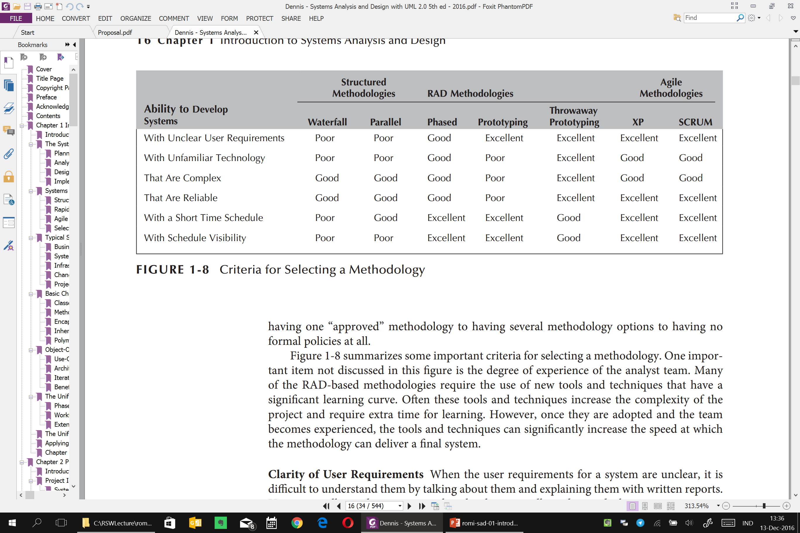
Selection Factors

Slide 34

Structured vs Object Oriented Method

Slide 35
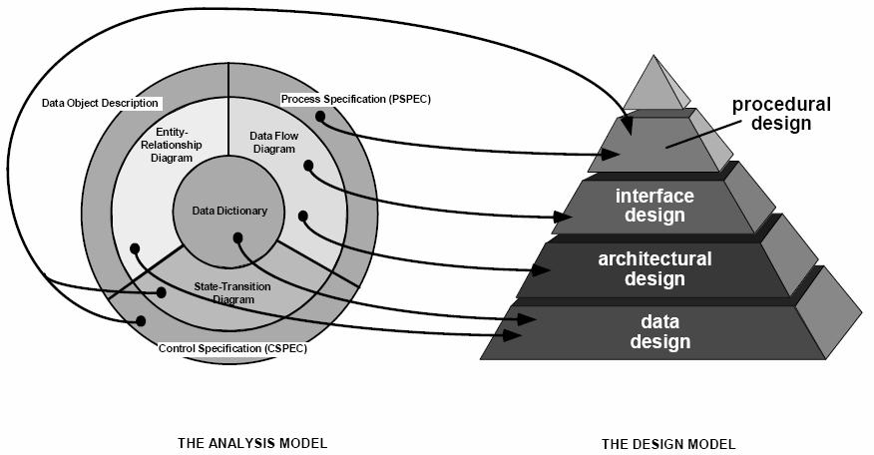
Structured Method
Data (ERD) dan Fungsi (DFD) dipisahkan sendiri-sendiri
PB
SRS
PB: Proses Bisnis
SRS: Software Requirement Specifications
ERD: Entity Relationship Diagram
DFD: Data Flow Diagram

Slide 36
Object Oriented Method
Tool→Unified Modeling Language(UML)
Data dan Fungsi dijadikan satu yang di enkapsulasi pada CLASS
Object Oriented Analysis (OOA) dan Object Oriented Design (OOD) dari Peter Coad dan Edward Yourdon [1990].
Object Modeling Technique (OMT) dan James Rumbaugh, Michael Blaha, William Premerlan, Frederick Eddy dan William Lorensen [1991].
Object-Oriented Software Engineering (OOSE) Ivar Jacobson [2000].
Booch Method dan Grady Booch [1994].
Sritrop dan Steve Cook dan John Daniels [1994].
Rational Unified Process (RUP) Rational Software Corporation [2003]
Iconix Process [2011]
…etc

Slide 37
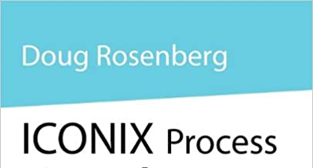
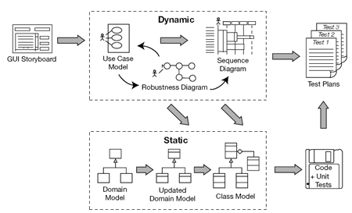
Self Explore
ICONIX PROCESS
2011

